Slide 1


Chapter 15
Evaluation Studies:
From Controlled to Natural Settings

Slide 2
The aims:
• Explain how to do usability testing
• Outline the basics of experimental design
• Describe how to do field studies
Notes:
2

Slide 3
Usability testing
Involves recording performance of typical users doing typical tasks.
Controlled settings.
Users are observed and timed.
Data is recorded on video & key presses are logged.
The data is used to calculate performance times, and to identify & explain errors.
User satisfaction is evaluated using questionnaires & interviews.
Field observations may be used to provide contextual understanding.
Notes:
3

Slide 4
Quantitative performance measures
Number of users successfully completing the task
Time to complete task
Time to complete task after time away from task
Number and type of errors per task.
Number of errors per unit of time
Number of navigations to online help or manuals
Number of users making a particular type of error
From Wixon and Wilson, 1997 but still relevant
Notes:
4

Slide 5
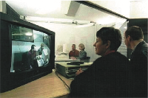
Usability lab with observers watching a user & assistant

Slide 6
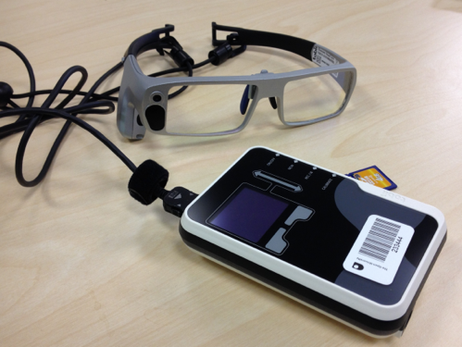
Tobii Glasses Mobile Eye-Tracking System
Source: Dalton et al., 2015, p.3891. Reproduced with permission of ACM Publications

Slide 7
Portable equipment for use in the field
The setup used in the Chicago usability testing sessions
Source: http://www.nngroup.com/reports/ipad-app-and-website-usability.
Used courtesy of the Neilsen-Norman Group

Slide 8
Testing the iPad usability
First study was conducted quickly in two cities: Fremont, CA and Chicago
Tests had to be done quickly as information was needed by 3rd party app developers
Also needed to be secretly so that the competition was not aware before the iPad was launched.
7 participants with 3+ months experience with iPhones
Signed an informed consent form explaining:
what the participant would be asked to do;
the length of time needed for the study;
the compensation that would be offered for participating;
participants’ right to withdraw from the study at any time;
a promise that the person’s identity would not be disclosed; and
an agreement that the data collected would be confidential and would be available to only the evaluators
Then they were asked to explore the iPad
Next they were asked to perform randomly assigned specified tasks

Slide 9
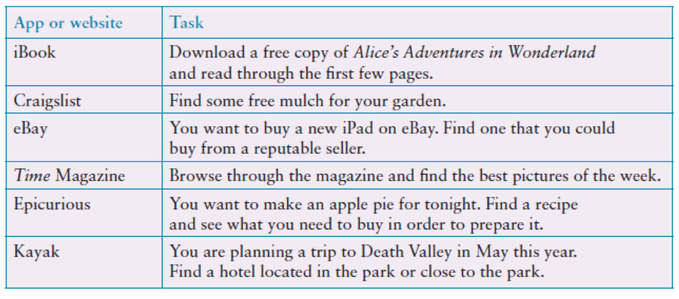
Examples of the tasks used in the iPad evaluation
Adapted from Budiu and Nielsen, 2010
Source: http://www.nngroup.com/reports/ipad-app-and-website-usability.
Used courtesy of the Neilsen-Norman Group

Slide 10
Problems and actions
Examples of problems detected:
Accessing the Web was difficult
Lack of affordance and feedback
Getting lost in an application
Knowing where to tap
Actions by evaluators:
Reported to developers
Made available to public on nngroup.com
Accessibility for all users important
Study did not address how iPad would be used in people’s everyday lives
Another study was done a year later to examine this and other issues that there was insufficient time to address in the first study

Slide 11
Usability testing conditions
Usability lab or other controlled space.
Emphasis on:
selecting representative users;
developing representative tasks.
5-10 users typically selected.
Tasks usually around 30 minutes
Test conditions are the same for every participant.
Informed consent form explains procedures and deals with ethical issues.
Notes:
11

Slide 12
How many participants is enough for user testing?
The number is a practical issue.
Depends on:
schedule for testing;
availability of participants;
cost of running tests.
Typically 5-10 participants.
Some experts argue that testing should continue until no new insights are gained.
Notes:
12

Slide 13
Usability testing & Experiments
Usability testing is applied experimentation.
Developers check that the system is usable by the intended user population by collecting data about participants’ performance on prescribed tasks.
Experiments test hypotheses to discover new knowledge by investigating the relationship between two or more variables.
Notes:
13

Slide 14
Usability testing & research
Usability testing
Improve products
Few participants
Results inform design
Usually not completely replicable
Conditions controlled as much as possible
Procedure planned
Results reported to developers
Experiments for research
Discover knowledge
Many participants
Results validated statistically
Must be replicable
Strongly controlled conditions
Experimental design
Scientific report to scientific community
Notes:
14

Slide 15
Experiments
Test hypothesis
Predict the relationship between two or more variables.
Independent variable is manipulated by the researcher.
Dependent variable influenced by the independent variable.
Typical experimental designs have one or two independent variables.
Validated statistically & replicable.
Notes:
15

Slide 16
Experimental designs
Different participants (between subjects) - single group of participants is allocated randomly to the experimental conditions.
Same participants (within subjects) - all participants appear in both conditions.
Matched participants (pairwise) - participants are matched in pairs, e.g., based on expertise, gender, etc.
Notes:
16

Slide 17
Different, same, matched participant design
Notes:
17

Slide 18
Field studies
Field studies are done in natural settings.
“In the wild” is a term for prototypes being used freely in natural settings.
Aim to understand what users do naturally and how technology impacts them.
Field studies are used in product design to:
identify opportunities for new technology;
determine design requirements;
decide how best to introduce new technology;
evaluate technology in use.
Notes:
18

Slide 19
A field study of a pain-monitoring device
Monitoring patients’ pain is a known challenge for physicians
Goal of the study was to evaluate the use of a pain-monitoring device for use after ambulatory surgery
Painpad was a keypad device
It was usability tested extensively in the lab before being taken into two hospitals.
Aim was to understand how painpad was used in the natural environment and routines in two UK hospitals.
How pain-monitoring with painpad differed from
Notes:
19

Slide 20
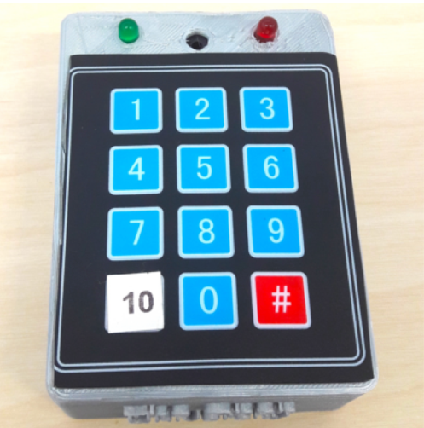
Painpad
A tangible device for inpatient self-logging of pain
Source: Price et al., 2018. Reproduced with permission of ACM Publications

Slide 21
Data collection & participants
Two studies in two hospitals involving 54 people
13 males, 41 females
Privacy was a important concern
Hospital stay ranged from 1-7 days, mean and median age 64.6, 64.5
Given painpad after surgery and prompted to report pain levels every two hours
Nurses also collected scores
All data entered into charts
Patients of one hospital were given a user-satisfaction survey when the left
Also rated painpad on a 1-5 Likert scale
Notes:
21

Slide 22
Data analysis & presentation
Three types of data were collected:
Satisfaction with painpad based on questionnaire responses,
Patients’ compliance with the two-hour routine,
How data collected from painpad compared with data collected by nurses.
Data showed:
Satisfaction with painpad 4.63 on Likert scale;
Patience compliance was mixed, some liked others disliked or didn’t notice the prompts;
Patients recorded more scores with Painpad than with the nurses

Slide 23
Key points
Usability testing takes place in controlled usability labs or temporary labs.
Usability testing focuses on performance measures, eg. how long and how many errors are made when completing a set of predefined tasks. Indirect observation (video and keystroke logging), user satisfaction questionnaires and interviews are also collected.
Affordable, remote testing systems are more portable than usability labs. Many also contain mobile eye-tracking and other devices.
Experiments test a hypothesis by manipulating certain variables while keeping others constant.
The experimenter controls independent variable(s) in order to measure dependent variable(s).
Field studies are evaluation studies that are carried out in natural settings to discover how people interact with technology in the real world.
Field studies that involve the deployment of prototypes or technologies in natural settings may also be referred to as ‘in the wild’ studies.
Sometimes the findings of a field study are unexpected, especially for in the wild studies that explore how novel technologies are used by participants in their own homes, places of work, or outside.
Notes:
23

